Slide 1
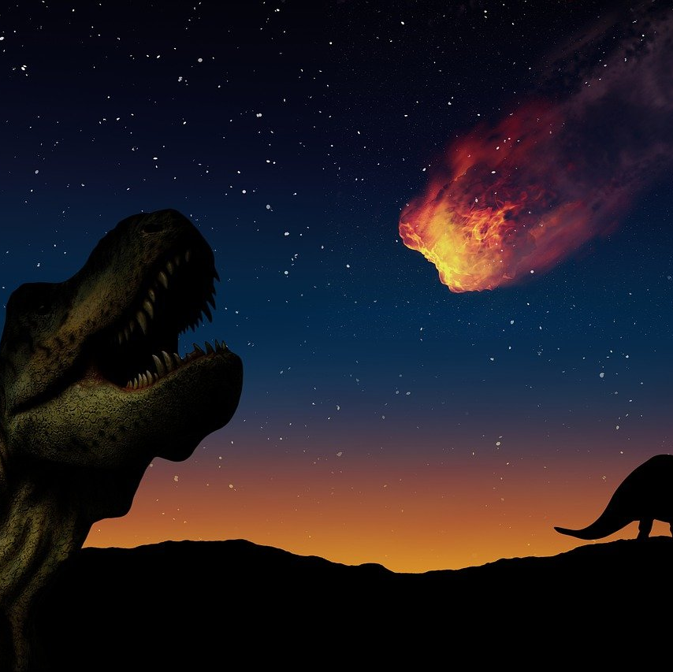
Asteroid Hazard Predictions
By Group 2, AKA the Space Cadets

Slide 2
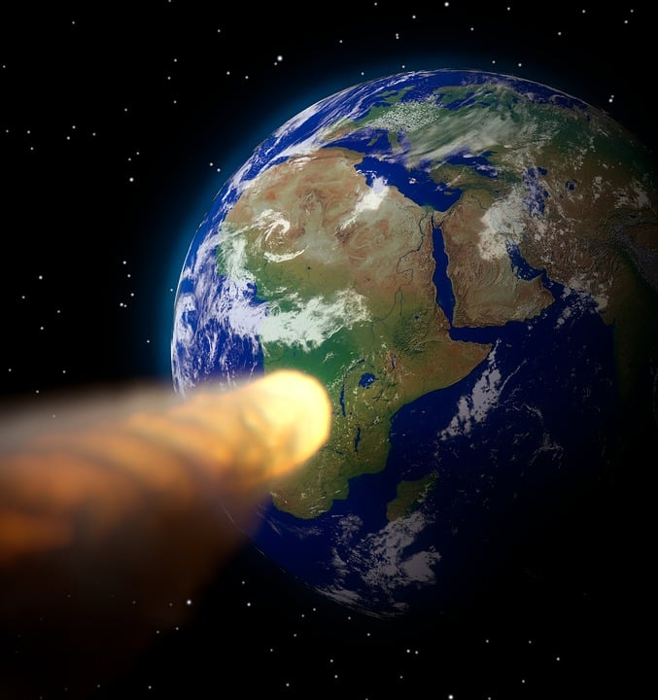
Target Data
Some asteroids were marked “hazardous” in the data
We trained our model to identify asteroids that are potentially hazardous
The rest are features, defined briefly here (note: some definitions have been greatly simplified for brevity’s sake)

Slide 3
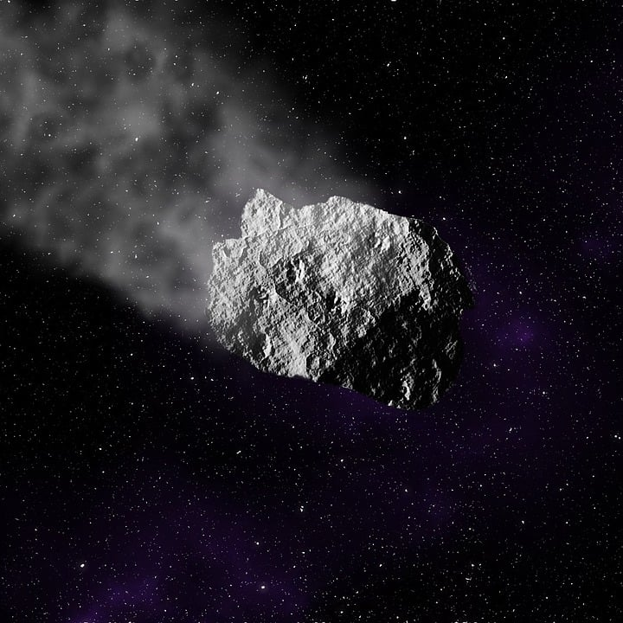
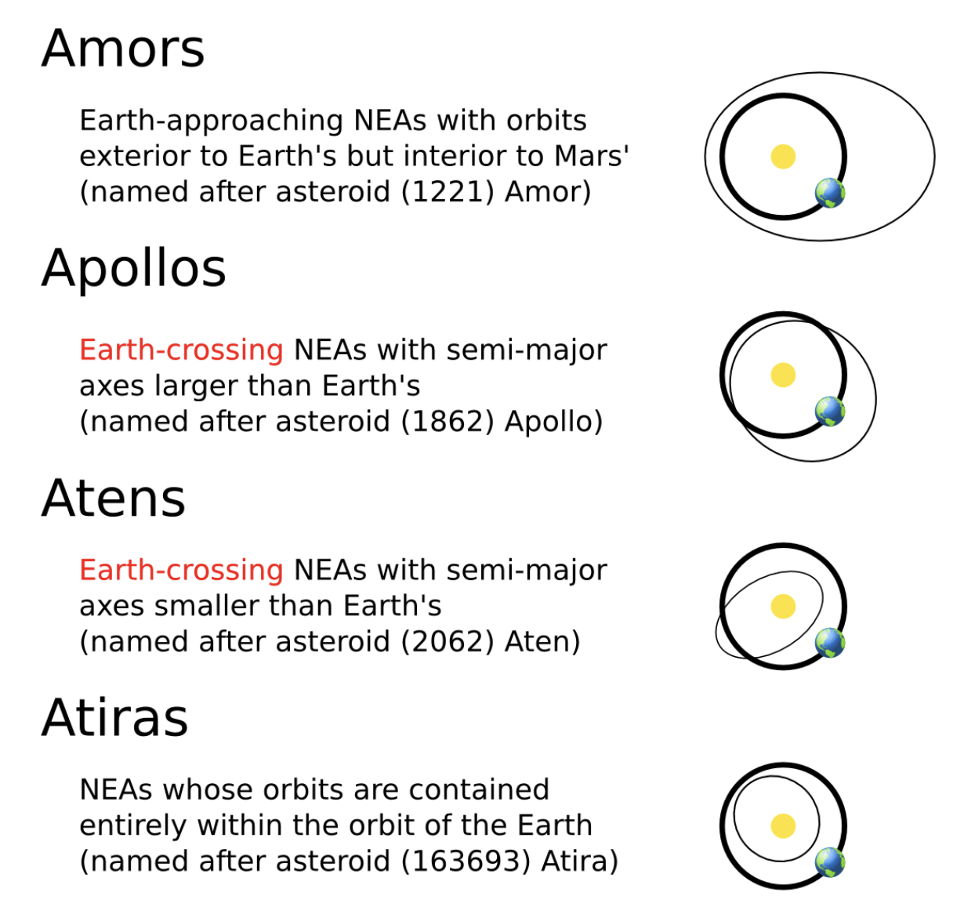
Types of Near Earth Asteroids (Classification)

Slide 4

Asteroid Magnitude
How bright the asteroid appears to the naked eye (can be used to estimate size)

Slide 5
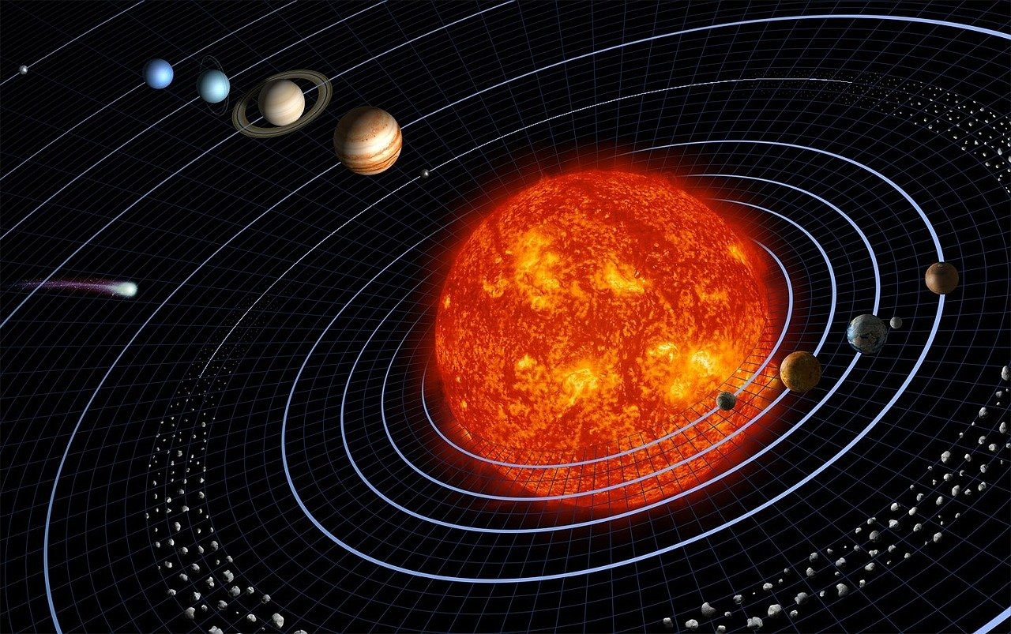
Orbit Eccentricity
The “roundness” of an orbit”

Slide 6
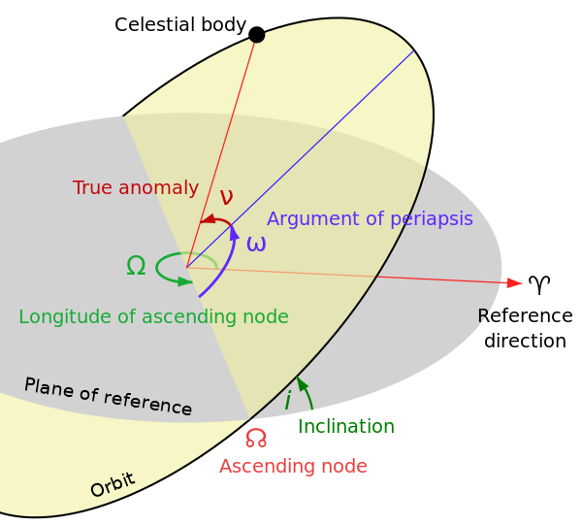
Orbital Inclination
The tilt of an orbit relative to the Plane of the solar system

Slide 7
Ascending node
The point in the orbit where the asteroid crosses the solar plane

Slide 8
Perihelion distance
A measure of the closest approach to the sun

Slide 9
Mean Anomaly
The angle between the perihelion point and the asteroid’s current position

Slide 10
Aphelion distance
A measure of the farthest distance from the sun

Slide 11
Orbital Period
How long the asteroid takes to make a full orbit, measured in Years

Slide 12
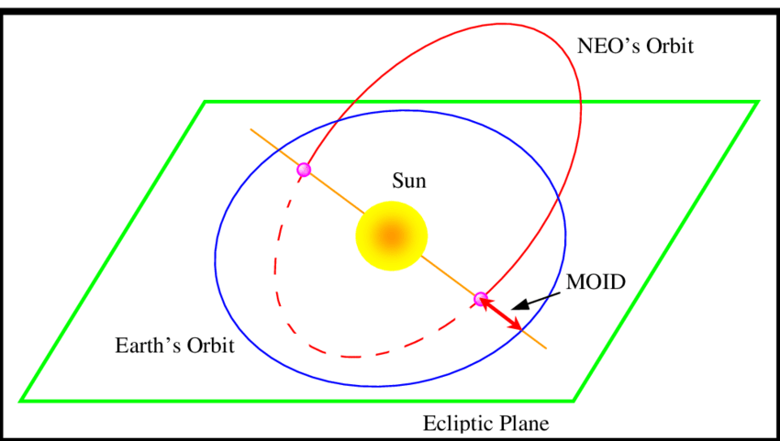
Minimum Orbit Intersection Distance
How close the Asteroid is to the Earth’s orbit at its closest point

